Slide 1
软工作业 RAY TRACING
An Introduction to Ray Tracing
By 25组

Slide 2
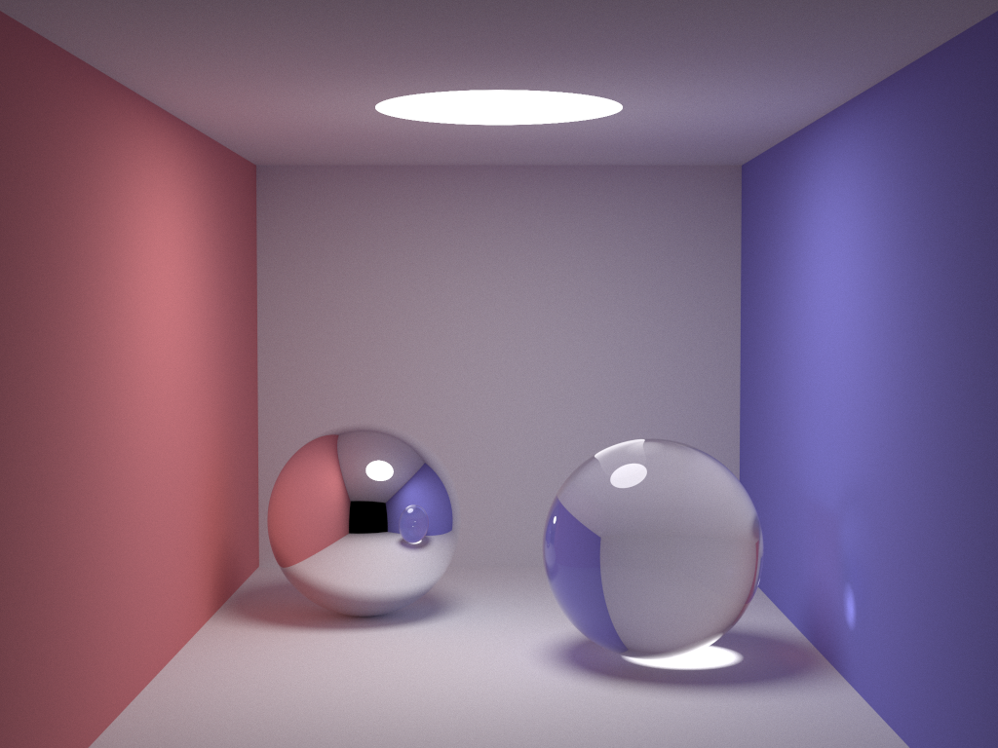
Feature: stochastic ray tracing
http://www.kevinbeason.com/smallpt/

Slide 3
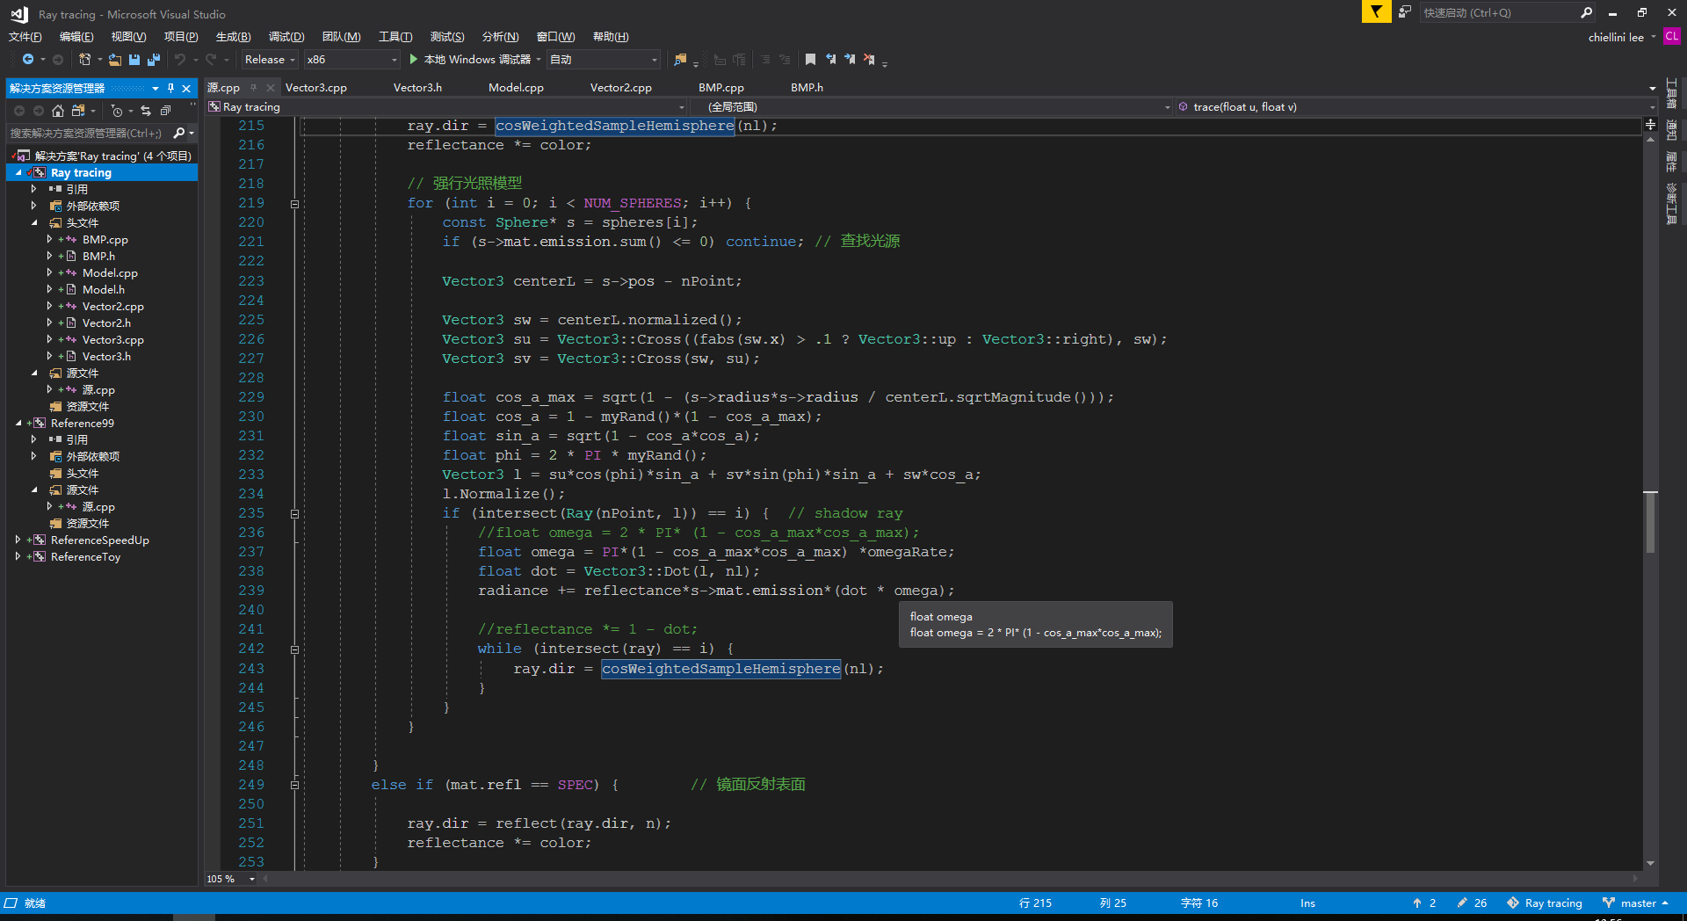
工具—vs ,vscode,github,bash

Slide 4
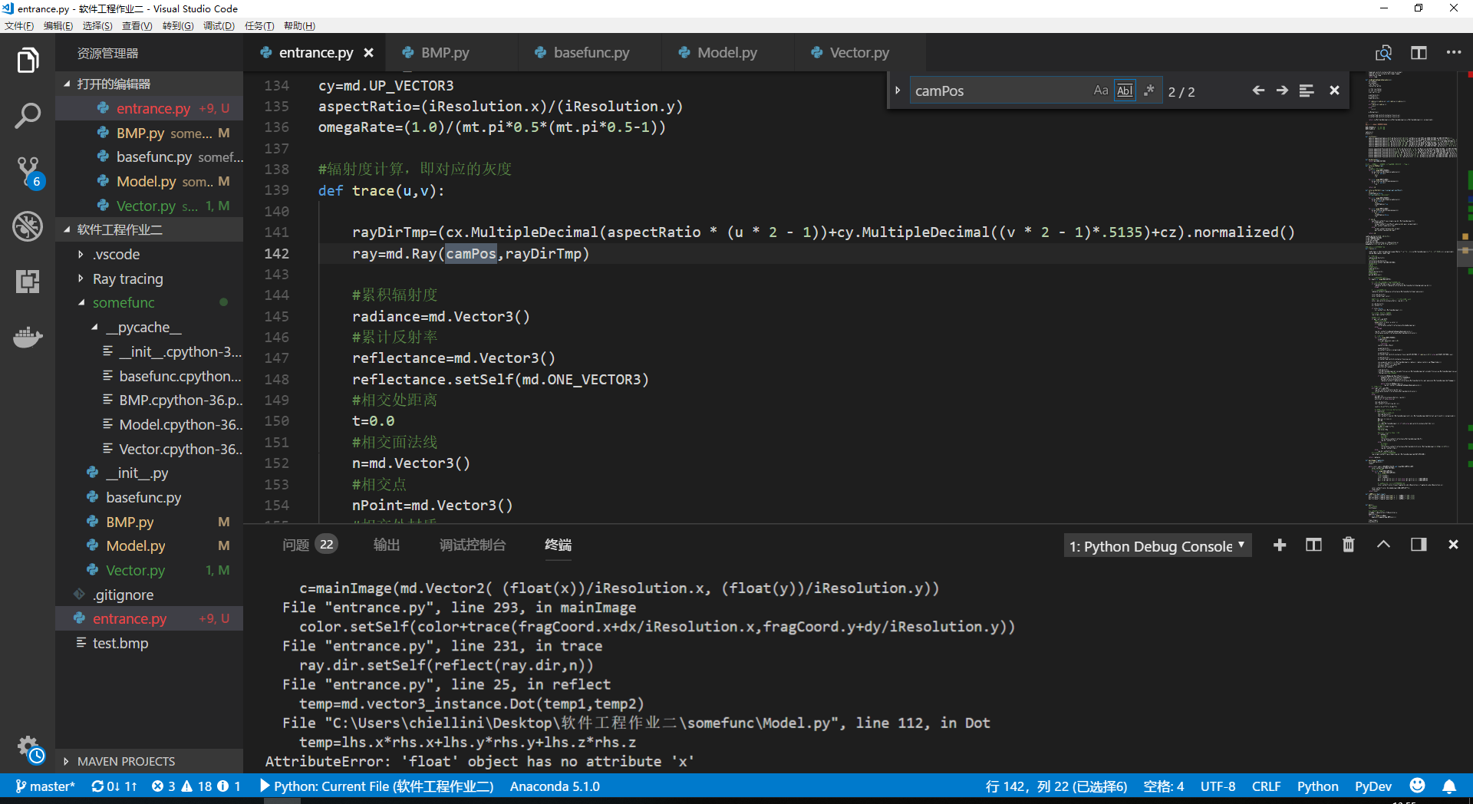
工具—vs ,vscode,github,bash

Slide 5
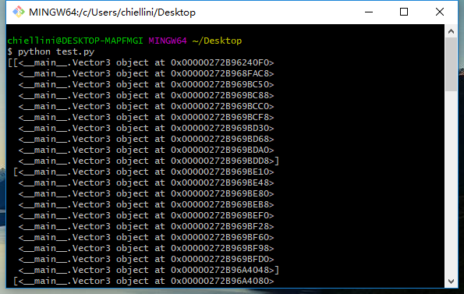
工具—vs ,vscode,github,bash

Slide 6
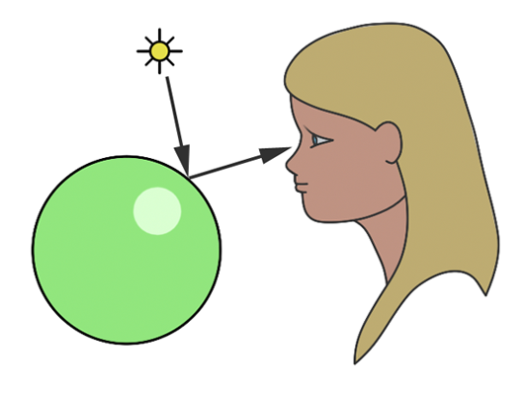
光线追踪
一言以蔽之，就是以追踪光线(光子)的方式来找出看到的“东西” 是什么。

Slide 7
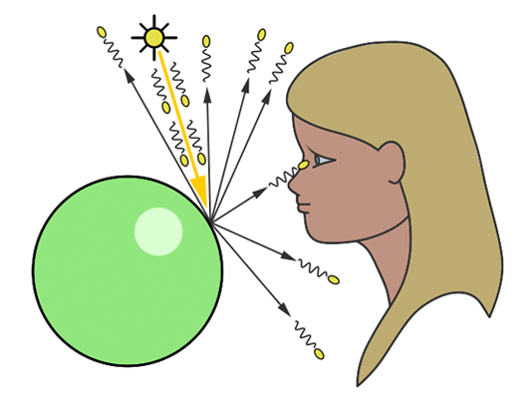
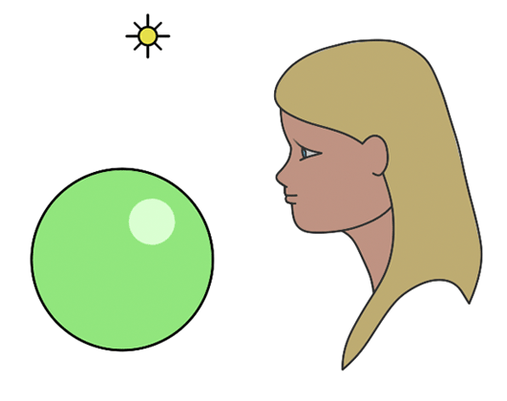
正向 vs. 逆向？
正向光线追踪
Forward ray-tracing or light tracing
大自然的方式
很多光线最终不会到达眼睛
逆向光线追踪
Backward ray-tracing or eye tracing
一种更高效的方式

Slide 8
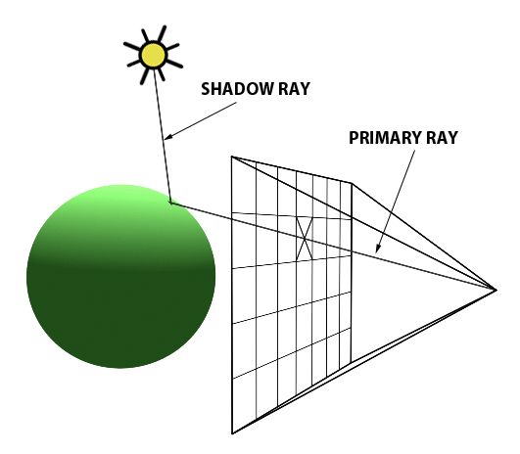
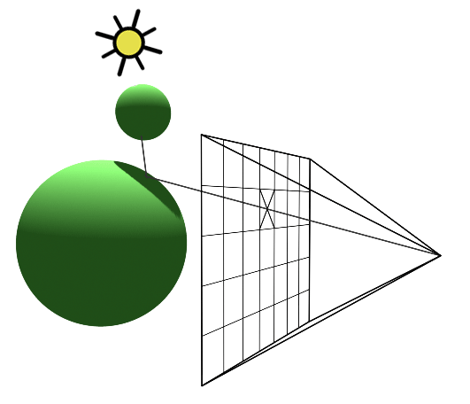
早期的光线追踪
从相机发出一条“主要光线”(primary ray)
相交后，向光源发射一条“阴影光线”(shadow ray)
如果“阴影光线”没有和其他物体相交，说明相交点被光源照到，计算其亮度
如果“阴影光线”被其他物体“遮挡”，说明相交点在阴影中

Slide 9
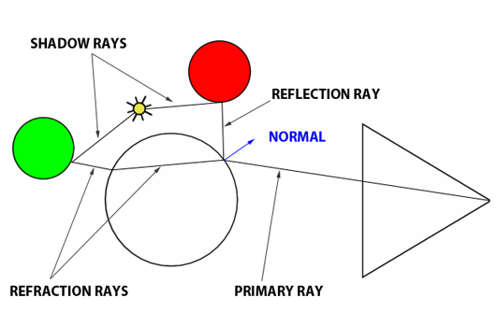
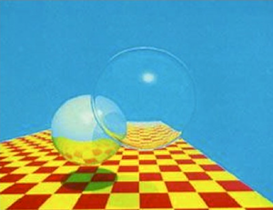
Whitted-style Ray-Tracing
1980 年由 Turner Whitted 提出
遇到镜面/透明表面，按照反射/折射定律发射出一条新光线
若遇到慢反射表面，按之前方法计算其亮度
递归地追踪下去，直到达到最大深度
解决了光栅化难以渲染反射/折射效果的难题

Slide 10
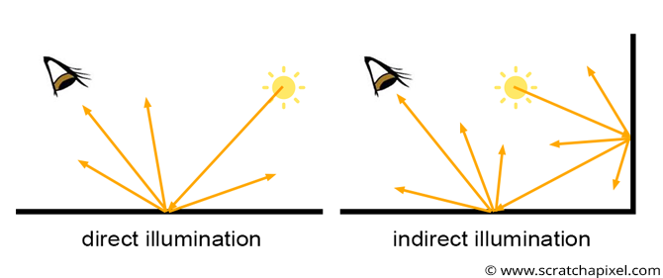
全局光照
什么是全局光照(Global Illumination)？
全局光照 = 直接光照 + 间接光照

Slide 11
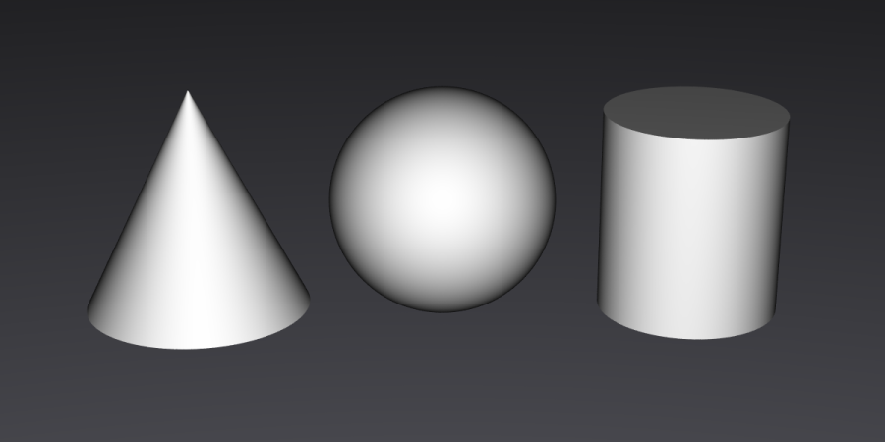
一个简单的场景，只有高光

Slide 12
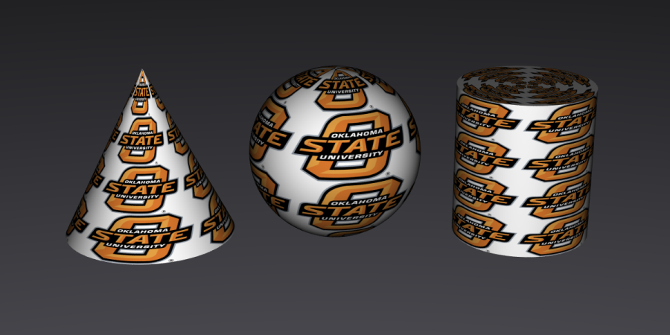
加上表面细节（颜色、纹理）

Slide 13
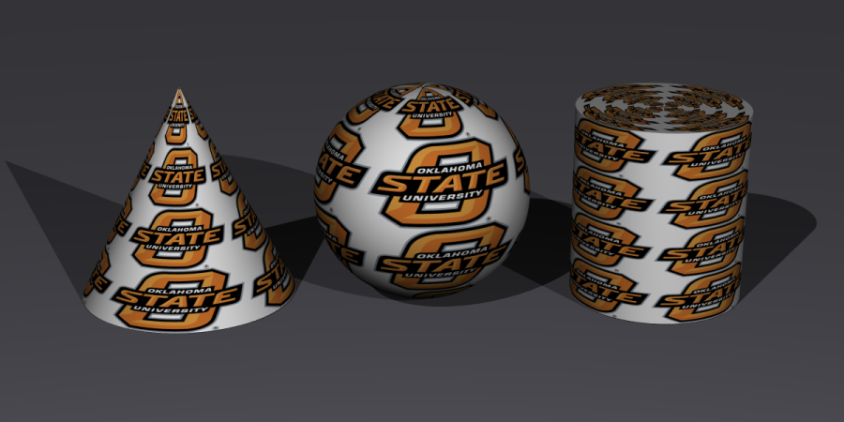
加入直接光照、硬阴影

Slide 14
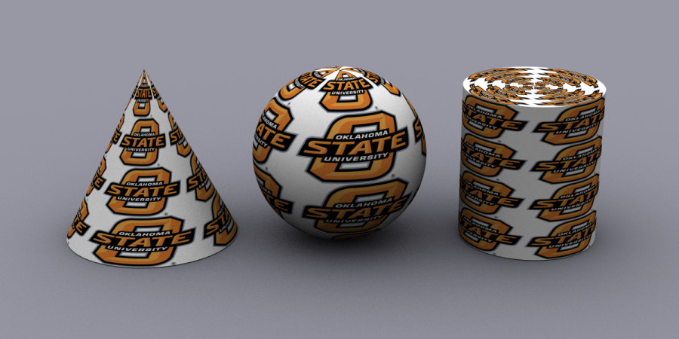
环境光遮罩(Ambient occlusion)
= direct lighting of a cloudy day.

Slide 15
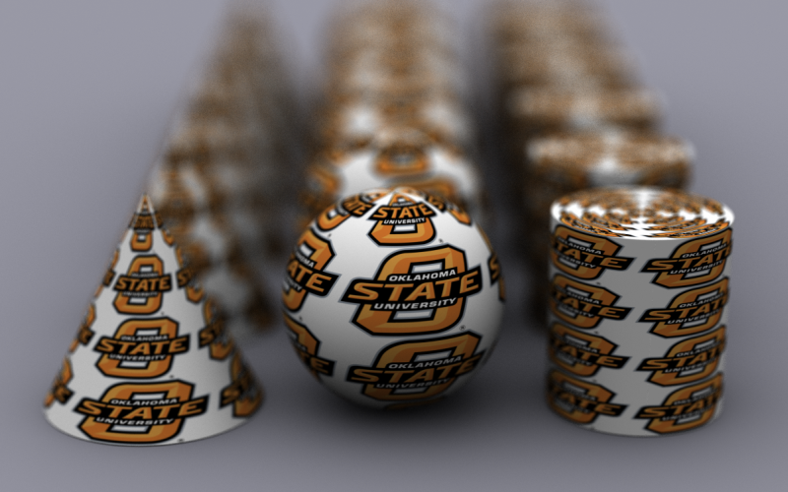
环境光遮罩+景深

Slide 16
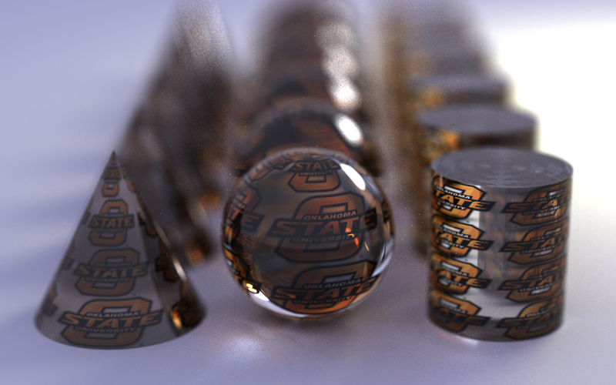
全局光照
全局光照表现了更丰富分表面属性（比如玻璃），并且带有散焦（ caustics，光线聚集在一起的效果 ）

Slide 17
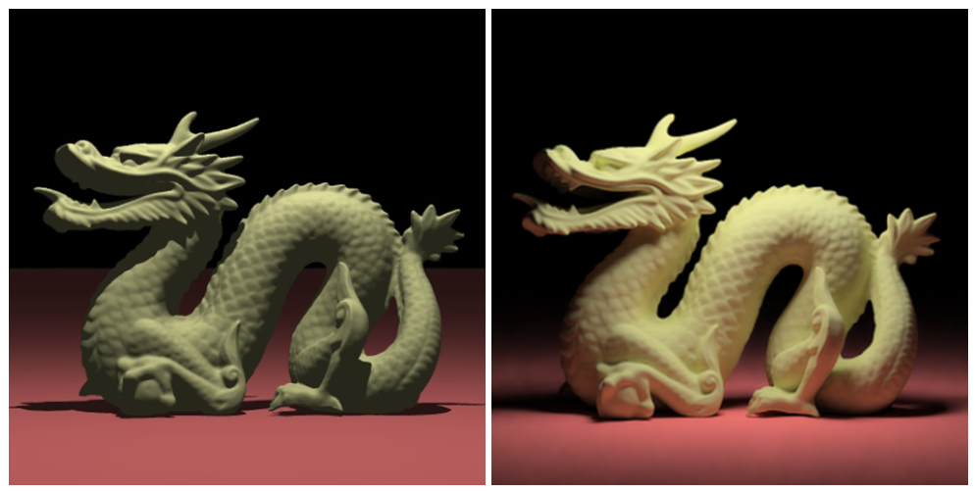
另一个例子
点光源 vs. 全局光

Slide 18
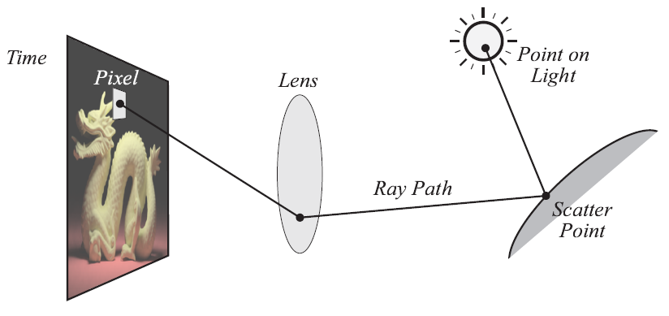
怎样生成有全局光照的图片?

Slide 19
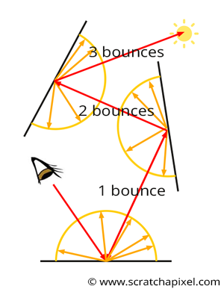
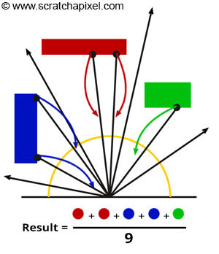
路径追踪算法 & 全局光照

Slide 20
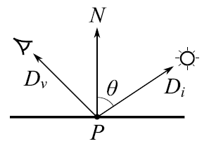
渲染方程(The Rendering Equation)

Slide 21
渲染方程(The Rendering Equation)
表面上一点P沿方向D_{v} 的出射辐射率（光照强度）
这是我们要计算的部分

Slide 22
渲染方程(The Rendering Equation)
P点沿方向D_{v} 的自发光辐射率
(如果P点不是光源，这一项为0)
可以通过查找场景定义知道这一项的值

Slide 23
渲染方程(The Rendering Equation)
反射项. 这里我们需要累计 (积分) 所有从整个半球方向
照射到P点的光, 乘以它散射到方向 D_{v} 的概率
(基于 BRDF 函数, F_{s})

Slide 24
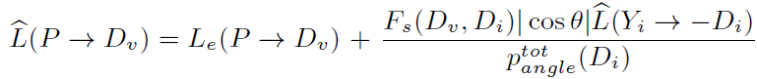
路径追踪方法求解渲染方程
用有相同期望（平均）值的Monte Carlo
(随机) 采样替代积分计算
然后平均采集的样本，得到一幅平滑的图像

Slide 25
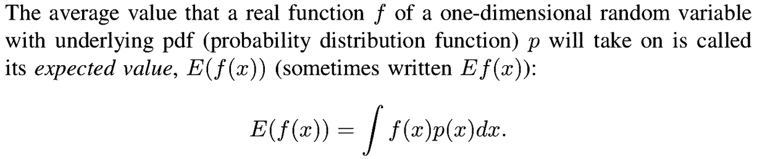
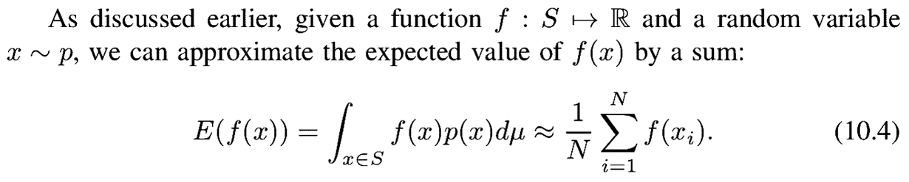
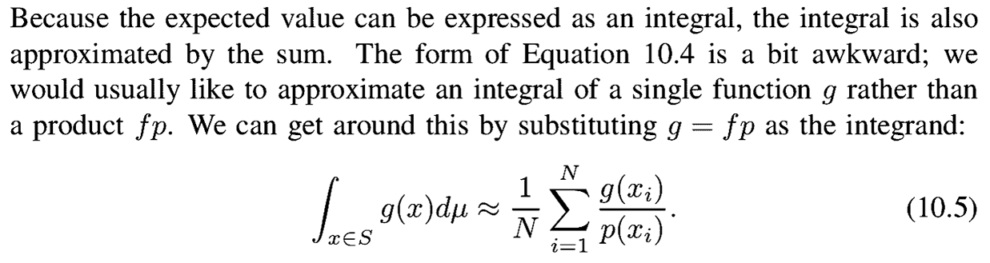
Monte Carlo方法
From Realistic Ray Tracing (Shirley and Morley)

Slide 26
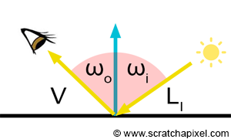
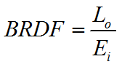
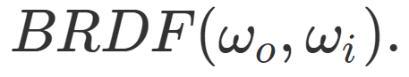
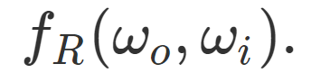
BRDF
BRDF 可以被认为是出射光与入射光的比值
衡量BRDF是否符合物理的三个性质：
取值永远大于等于0
互换出入射光的位置，取值不变
能量守恒（整个半球面上的出色光能量小于入射光能量）

Slide 27
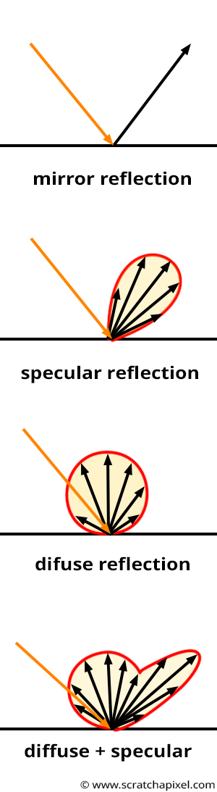
常见的BRDF
我们可以画出反射光线大致的分别来可视化BRDF

Slide 28
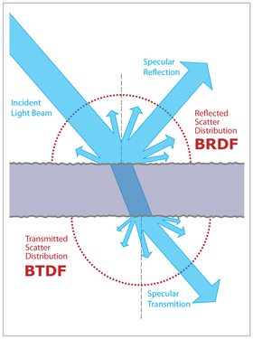
BSDF: BRDF + BTDF
BRDF 没有描述折射，散射等等表面属性，BSDF是对其的扩展
BSDF能描述更多类型的表面：如透明材质，次表面散射等等

Slide 29
Smallpt: Global Illumination in 99 lines of C++
http://www.kevinbeason.com/smallpt/
Demo 基于 shadertoy 编写
由于shader中不支持递归，需要把递归的路径追踪算法改为迭代形式

Slide 30
迭代形式
展开表达式，得到路径追踪的迭代形式
L0 = Le0 + f0*(L1)
= Le0 + f0*(Le1 + f1*L2)
= Le0 + f0*(Le1 + f1*(Le2 + f2*(L3))
= Le0 + f0*(Le1 + f1*(Le2 + f2*(Le3 + f3*(L4)))
= ...
= Le0 + f0*Le1 + f0*f1*Le2 + f0*f1*f2*Le3 + f0*f1*f2*f3*Le4 + ...
So:
F = 1;
while (true) {
L += F*Lei;
F *= fi;
}

Slide 31
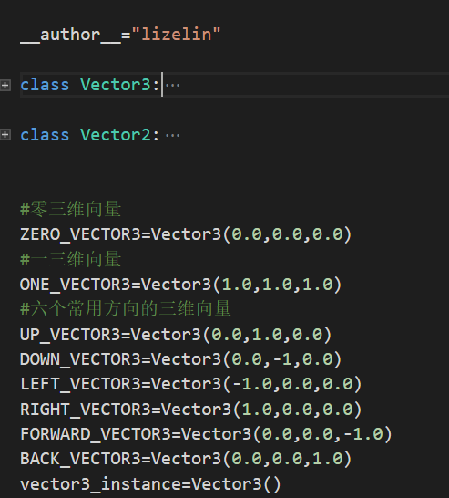
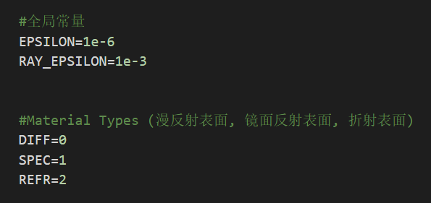
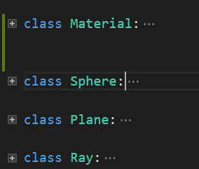
Consts and Struct

Slide 32
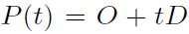
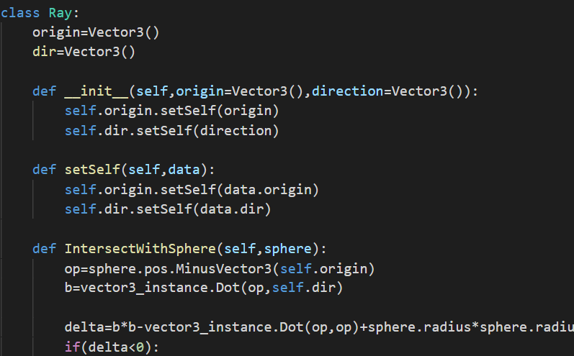
Ray Structure
A ray is a parametric line with an origin (o) and a direction (d). A point along the ray can be defined using a parameter, t:
In code we have:
The core routines of the ray tracer intersect rays with geometric objects(in our case sphere and plane)

Slide 33
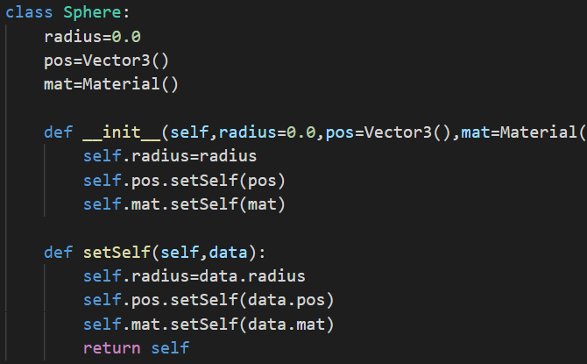
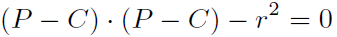
Sphere
We can define a sphere based on
a center point
Radius
The equation of the sphere:
In vector form:

Slide 34
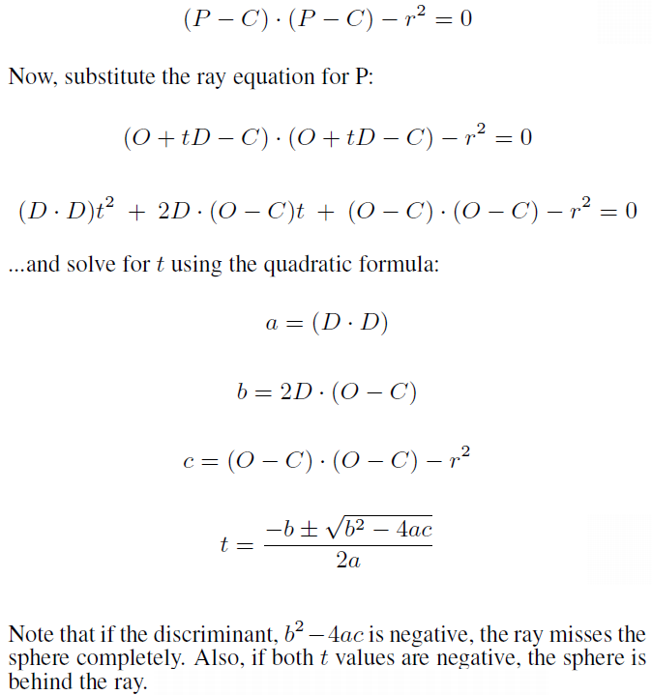
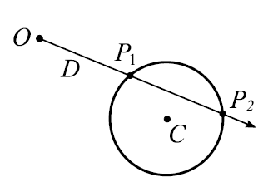
Sphere Intersection
Start with vector equation of sphere

Slide 35
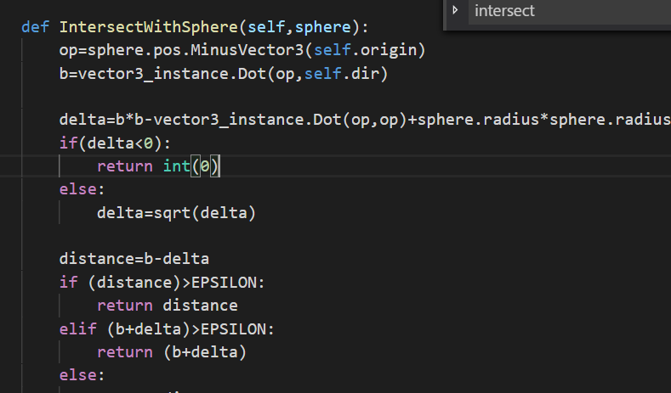
Intersection Routine

Slide 36
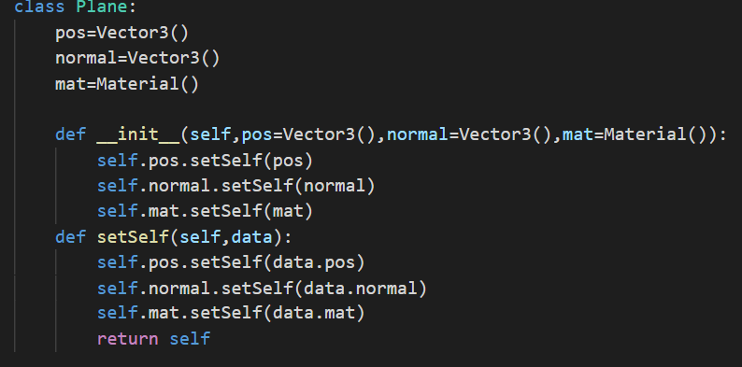
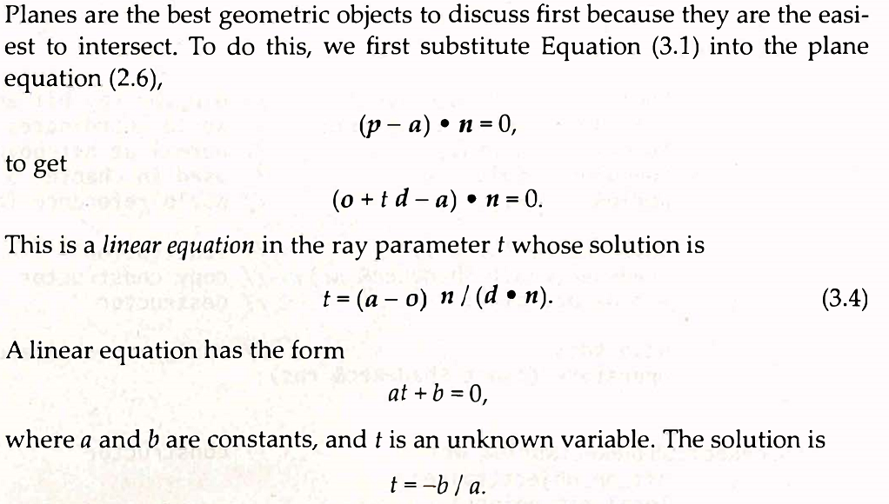
Plane Intersection
a plane is defined based on
a center point (can be any point on plane)
Normal

Slide 37
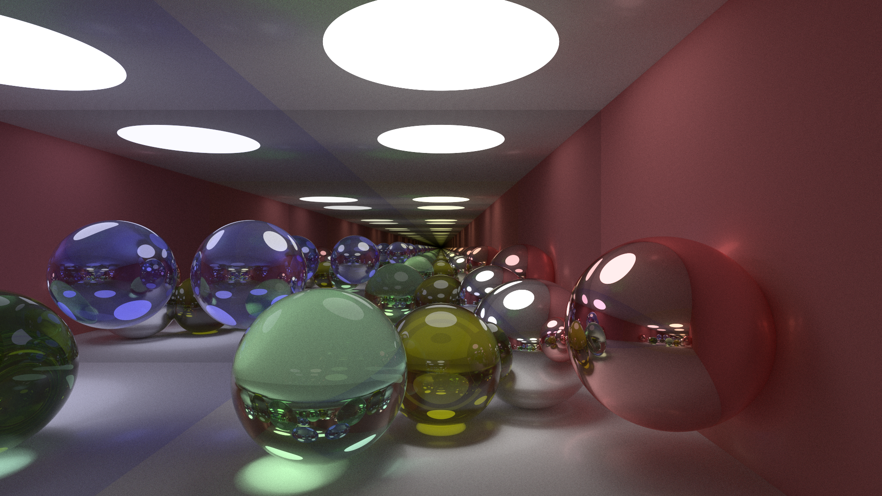
The Scene

Slide 38
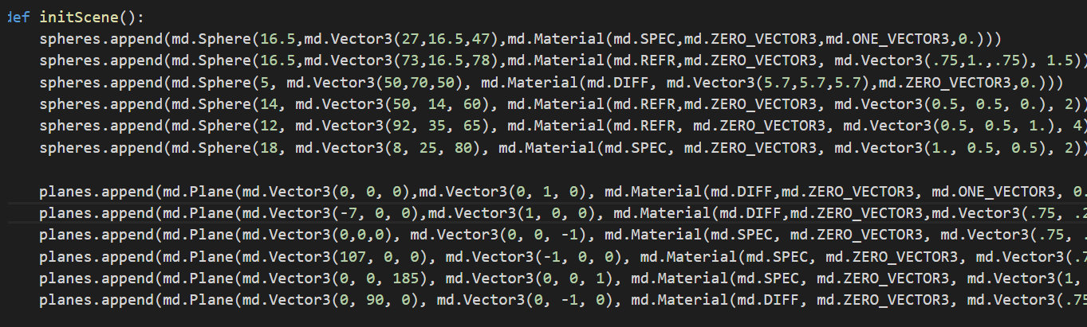
The Scene Description

Slide 39
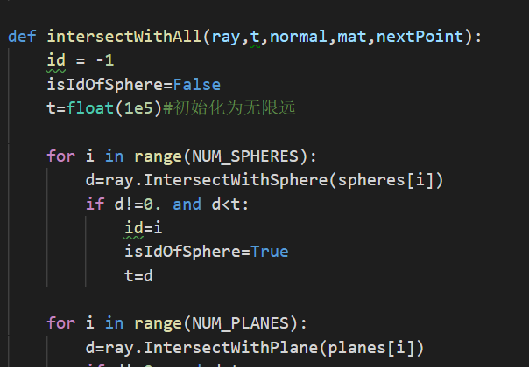
Intersect Ray with Scene
Check each sphere and each plane, one at a time. Keep the closest intersection.

Slide 40
The main Function
Set up camera coordinates
For each pixel
Do NxN subpixels
Average a number of radiance samples
Save value in the texture

Slide 41
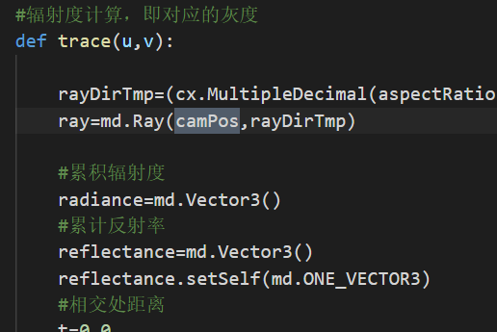
Generate Ray from Camera
Look from and gaze direction:
(assumes upright camera)
(0.5135 defines field of view angle)
(cross product gets vector perpendicular to both cx and gaze direction)

Slide 42
Camera Setup
cy
gaze
direction
cx
look
from

Slide 43
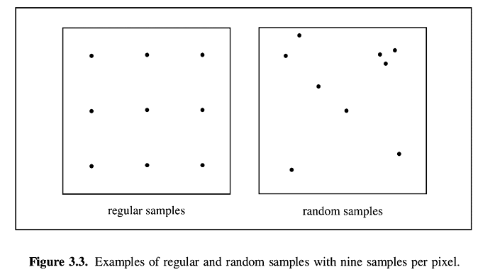
Sampling

Slide 44



Sampling

Slide 45

Tent Filter
From Realistic Ray Tracing (Shirley and Morley)

Slide 46

Tent Filter
From Realistic Ray Tracing (Shirley and Morley)

Slide 47

Single Sample

Slide 48

Box Filter

Slide 49

Tent Filter

Slide 50

trace (1: do intersection)
id used to determine hit or miss
ray the ray we are casting
depth the ray depth
t distance from hit point to
n surface normal of the hit point
Mat surface Material of the hit point

Slide 51

trace (2)

Slide 52

Russian Roulette
Stop the recursion randomly based on the surface reflectivity.
Use the maximum component (r, g, b) of the surface color.
Divide surface color by p to achieve “energy conservation” .
It save a large amount of computational resources, but will still give an unbiased result.

Slide 53

Orienting Normal
When a ray hits a glass surface, the ray tracer must determine if it is entering or exiting glass to compute the refraction ray.
The dot product of the normal and ray direction tells this:

Slide 54


Diffuse Reflection
For diffuse (not shiny) reflection
Send out a random sample (recursive)
Sample all lights, aka Explicit Light Sampling (non-recursive)

Slide 55

Construct random ray:
Get random direction on unit hemisphere
Use normal to create orthonormal coordinate frame

Slide 56


Using Polar Coordinates

Slide 57



Cosine Weighted Sampling
Uniform : e = 0
Cosine weighted : e = 1

Slide 58

Sampling Unit Hemisphere
There is another common way to generate a cosine weighted hemisphere sampler is to generate uniform points on a disk, and then project them up to the hemisphere.

Slide 59

Rotate Sample Towards Normal

Slide 60


Ideal Specular (Mirror) Reflection
Reflect – a GLSL provided function
Reflected Ray:
Angle of incidence =
Angle of reflection

Slide 61

Glass (Dielectric)

Slide 62

Reflected Ray & Orientation
Determine if ray is entering or exiting glass
IOR for glass is 1.5. nnt is either 1.5 or 1/1.5
Glass is both reflective and refractive, so we compute the reflected ray here.

Slide 63
Total Internal Reflection
Total internal reflection occurs when the light ray attempts to leave glass at too shallow an angle.
If the angle is too shallow, all the light is reflected.

Slide 64

Reflect or Refract using Fresnel Term
Compute the refracted ray

Slide 65


Refraction Ray

Slide 66
Refractive Index(折射率)
Refractive index gives the speed of light within a medium compared to the speed of light within a vacuum:
Water: 1.33
Plastic: 1.5
Glass: 1.5 – 1.7
Diamond: 2.5
Note that this does not account for dispersion (色散). To account for these, vary index by wavelength.

Slide 67

Fresnel Reflectance(菲涅耳反射)
Percentage of light is reflected (and what refracted) from a glass surface based on incident angle (ϴ_{a})
Reflectance at “normal incidence”, where (n=n_{a}/n_{b})
Reflectance at other angles:

Slide 68
Reflect or Refract using Fresnel Term
Fresnel Reflectance
R0 = reflectance at normal incidence based on IOR
c = 1-cos(theta)
Re = fresnel reflectance

Slide 69

Reflect or Refract using Fresnel Term
P = probability of reflecting
Russain roulette

Slide 70

Convergence
From: http://kevinbeason.com/smallpt/

Slide 71
优化

